Slide 1
Kaggle Active User’s Country And Region Breakdown

Slide 2
AIM:
To analyze the distribution of active users on Kaggle based on their countries and regions.
Gather data from Kaggle's user database or any publicly available datasets that provide information about Kaggle users. This data may include user profiles, activity logs, or any other relevant information.

Slide 3
INTRODUCTION:
Kaggle, a well-known platform for data science and machine learning enthusiasts, has grown to become a vibrant global community of data practitioners, researchers, and learners.
As the platform continues to foster collaboration, knowledge sharing, and competition, understanding the geographical distribution of its active user base becomes a compelling area of interest.
This analysis aims to provide insights into the distribution of active Kaggle users across different countries and regions

Slide 4
Problem Statement:
Geographic Distribution Analysis: Conduct a thorough examination of Kaggle's active user base to identify the countries and regions with the highest engagement levels. This will provide a clear picture of the platform's popularity across the globe.
Trends and Patterns Identification: Uncover any discernible trends or patterns in user activity based on different geographical locations. This may include variations in user interests, preferred competition types, or areas of expertise.
Demographic Insights: Gather insights into the demographics of active users, including age groups, educational backgrounds, and professional affiliations in various countries and regions.
Platform Enhancement Opportunities: Use the findings to propose actionable recommendations for Kaggle's team to enhance user experiences, offer targeted support, and foster growth in regions where engagement might be lower.

Slide 5
Methodology:
Data Preparation: Clean and preprocess the collected data to remove any inconsistencies, duplicates, or missing values.
Standardize country and region names to ensure uniformity in the analysis.
Country and Region Identification: Identify the country and region information for each active Kaggle user based on their profile data, IP addresses, or self-reported location.
Visual Representation: Create visual aids like world maps, bar charts, or pie charts to present the data in an understandable and visually appealing manner.

Slide 6
Analysis:
Line and Clustered Column Chart: Power BI will automatically aggregate the user IDs using the count function, creating a stacked column chart that shows the distribution of active users by country and region.
Gauge: There I will be used ‘percentage title’ part in to create user id divided calculate the sum to user ID, I will be created one Gauge visualization on the sheet (its used “country, Region, user ID”)and create slicer part on country

Slide 7
Tree map: There I will be find ‘Null’ values to insert in the part of Tree map and count of user ID to used on Region in power BI
Tree map & Slicer: There used a Tree map visualization for userid is automatly count function is active and region
And there used into a country for slicing method in tree map to join in one visualization function in power BI
Bookmark : There using a Bookmark in power BI function to used a selection function also and using country and Region on the Button function.
Filled map & Slicer : There are using a filled map on count(user ID),country, Region in power BI on Visualization.
And using a slicer method for country on Power Bi on Visualization.

Slide 8
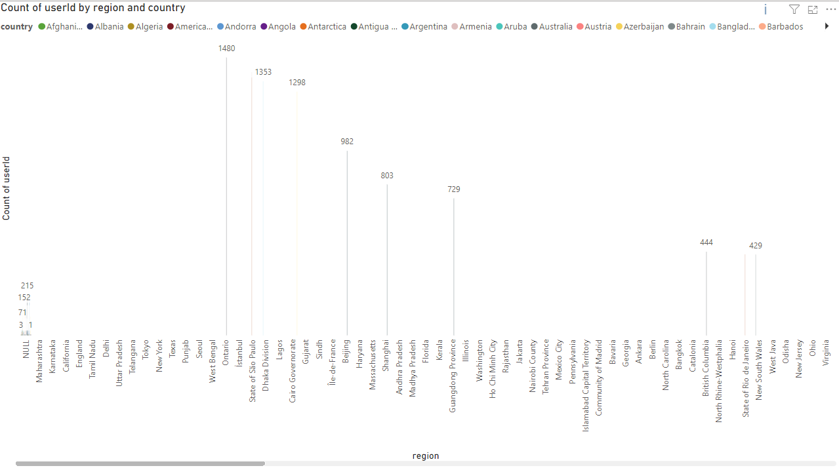
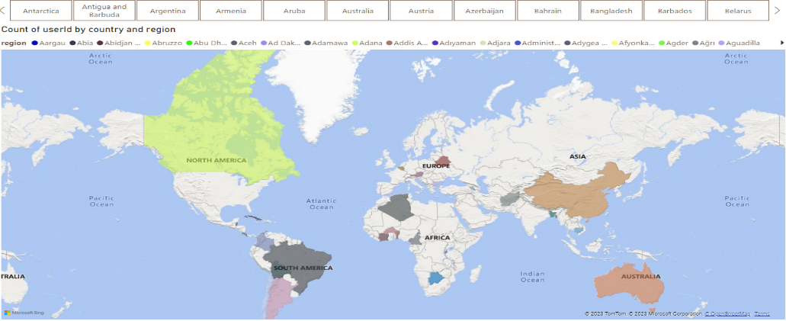
Insights:
Line and clustered column chart
Map & slicering
Data Import: Import the dataset containing user information, including user IDs, Region, and Country, into Power BI.
Data Transformation: Ensure that the data is properly structured and clean. If needed, create relationships between tables to establish the hierarchy between Region, Country, and user IDs.
Line and Clustered Column Chart: Add a Line and Clustered Column Chart visual to the report canvas. This visual will allow you to combine the line chart and clustered column chart in a single visualization.
Axis Configuration: Configure the chart to have the Region and Country on the x-axis, and the count of user IDs on the y-axis. The line chart will represent the overall count of user IDs across all Regions and Countries, while the clustered column chart will break down the count based on the individual Regions and Countries.
Visualization Options: Customize the chart to display the data effectively. You can choose different colors for the line and columns, adjust the axis labels, and add a legend for clarity.
Data Labels: Enable data labels on the chart to show the count of user IDs directly on the columns and the line.
Interaction and Drill-Down: Utilize Power BI's interaction and drill-down functionality to allow users to explore the data further. For instance, users can click on a specific Region or Country in the clustered column chart to drill down into the detailed count of user IDs for that location.
Data Exploration: Encourage users to interact with the chart to gain insights into user distribution across different Regions and Countries. Users can observe the overall trend of user IDs through the line chart and compare the counts among Regions and Countries with the clustered columns.
ToolTips: Include tooltips on the chart to provide additional information when users hover over data points. This will enhance the user experience and provide context for the data being displayed.
Data Import: Import the dataset containing user information, including user ID, Region, and Country, into Power BI.
Map Visualization: Add a Map visual to the report canvas. Use the user ID data to plot user locations on the map. The map should display markers representing the geographical locations of users based on their Region and Country.
Slicing by Country: Add a slicer to the report that allows users to select specific countries. This slicer will enable users to filter the map visualization based on their chosen country.
Styling based on Title: Incorporate the Style Title data (e.g., job titles of users) as a color or size indicator for the map markers. You can use different colors or marker sizes to represent various user job titles, making the map more informative and visually appealing.
Interactive Experience: When users select a specific country using the slicer, the map visualization should update to display only the user markers from the chosen country. Additionally, the map markers should be styled according to the job titles (Style Title) of the users, providing insights into the distribution of job roles within the selected country.
Tooltips: Use tooltips on the map markers to display additional information, such as user names or other relevant details, when users hover over the markers. This enhances the user experience by providing context and details without cluttering the map.
Data Exploration: Encourage users to interact with the report by exploring different countries and observing the distribution of job titles across regions. This interactivity can provide valuable insights into the geographic concentration of users and the diversity of roles they occupy.

Slide 9
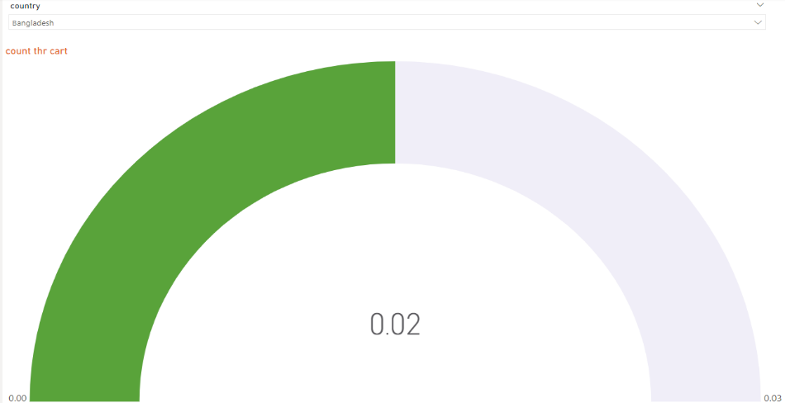
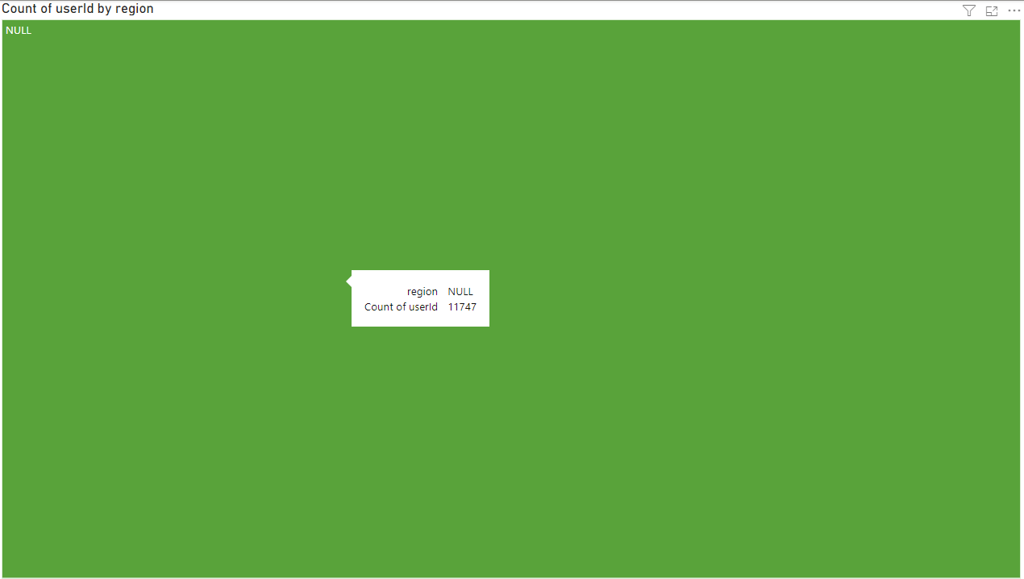
Gauge & slicing
Tree map
Data Import: Import the Kaggle's User List dataset into Power BI, which should include user information such as user ID, country, and other relevant attributes.
Gauge Visualization: Add a Gauge visual to the report canvas. The Gauge will serve as a performance indicator to display metrics such as user engagement or completion rates. You can set the Gauge to show the percentage of completed profiles or any other relevant metric based on the user list data.
Column Chart for Percentage Checking: Use a Column chart to show the percentage of completed profiles or any other specific metrics you want to analyze. For example, you can display the percentage of users with complete profiles versus those with incomplete profiles.
Slicing for Country in Dropdown: Add a Country slicer to the report, which allows users to select specific countries from a dropdown menu. This slicer will enable users to filter the data and focus on specific countries of interest.
Interactive Experience: When users select a country using the slicer, both the Gauge and Column chart visuals should update accordingly to reflect the data for the selected country.
Data Exploration: Encourage users to interact with the report by exploring different countries through the slicer and observing the corresponding changes in the Gauge and Column chart visuals.
Tooltip: Use tooltips on the Gauge and Column chart visuals to display additional information when users hover over data points. This provides context and details to enhance the user experience.
Data Import: Import the Kaggle's User List dataset into Power BI, which should include user information such as user ID, country, and other relevant attributes.
Gauge Visualization: Add a Gauge visual to the report canvas. The Gauge will serve as a performance indicator to display metrics such as user engagement or completion rates. You can set the Gauge to show the percentage of completed profiles or any other relevant metric based on the user list data.
Column Chart for Percentage Checking: Use a Column chart to show the percentage of completed profiles or any other specific metrics you want to analyze. For example, you can display the percentage of users with complete profiles versus those with incomplete profiles.
Slicing for Country in Dropdown: Add a Country slicer to the report, which allows users to select specific countries from a dropdown menu. This slicer will enable users to filter the data and focus on specific countries of interest.
Interactive Experience: When users select a country using the slicer, both the Gauge and Column chart visuals should update accordingly to reflect the data for the selected country.
Data Exploration: Encourage users to interact with the report by exploring different countries through the slicer and observing the corresponding changes in the Gauge and Column chart visuals.
Tooltip: Use tooltips on the Gauge and Column chart visuals to display additional information when users hover over data points. This provides context and details to enhance the user experience

Slide 10
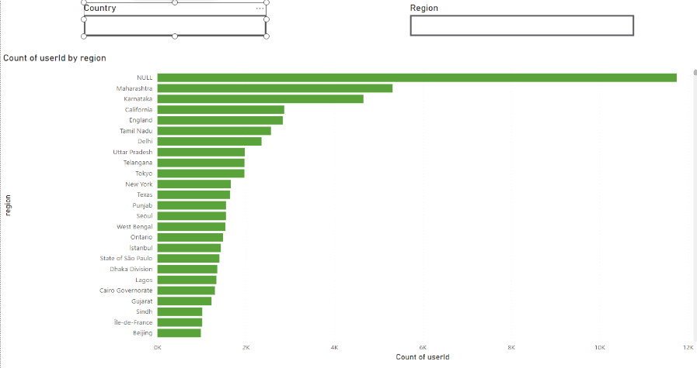
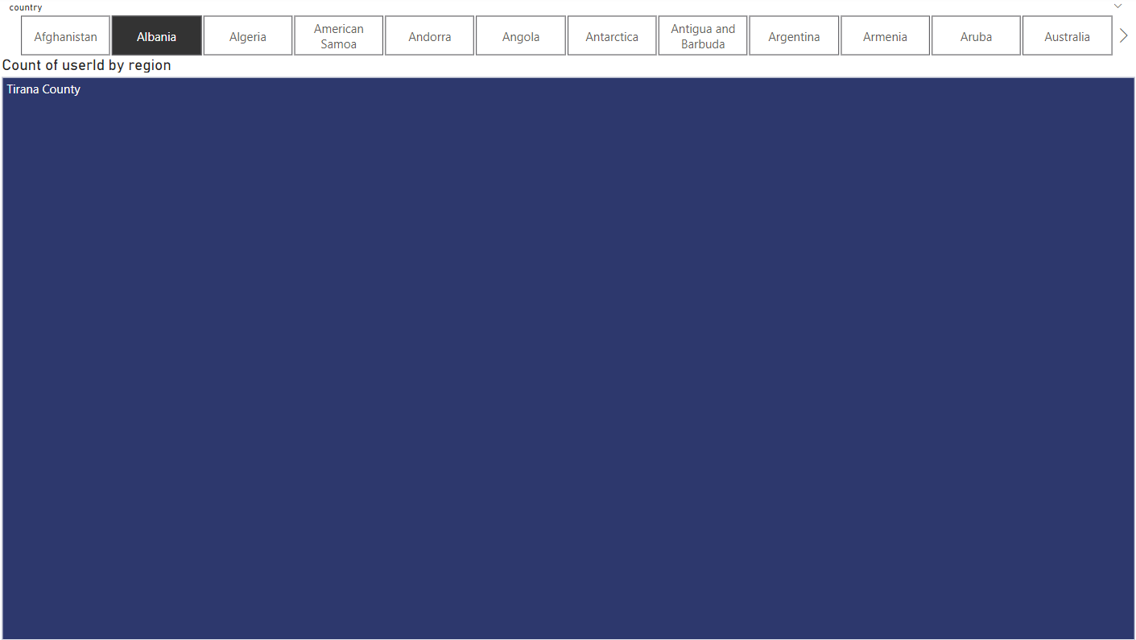
Bookmark
Tree map & slicing
Create a Blank Button: Start by adding a blank button visual to the report. This button will serve as a user interface element to toggle between country and region data.
Clustered Bar Charts: Next, create two clustered bar charts, one for country data and the other for region data. These charts will display the respective data based on user selection.
Using Selections: Utilize Power BI's selection feature to capture the user's interaction with the blank button. When the user clicks on the button, it triggers an event to show or hide specific visuals based on the selection.
Creating Bookmarks: Set up bookmarks in Power BI to save different report states based on user interactions. Create bookmarks for both the country and region views separately.
Interactivity: When the user clicks on the blank button, the selection event will hide one clustered bar chart (either country or region) and display the other. At the same time, the bookmark associated with the selected view (country or region) will be applied, showing the corresponding chart with the appropriate filters.
Toggle Functionality: The bookmark and selection combination allows users to toggle between the two clustered bar chart views (country and region) with a single click on the blank button.
,
Tree map Visualization: Start by creating a Tree map visual in Power BI. The Tree map is a hierarchical visualization that allows you to display hierarchical data using nested rectangles, with the size of each rectangle representing a measure (e.g., user count), and the rectangles grouped into categories based on the data hierarchy.
Data Setup: Use the user ID and Region data to set up the hierarchical structure for the Tree map. You can arrange the data in such a way that the Region is the parent category, and the user ID is the child category within each Region.
Slicing on Title type: Incorporate a slicer into the report to enable users to filter the data based on the "Title type." The slicer will display the available options for Title types, and users can select one or multiple options to filter the Tree map visualization accordingly.
Selected Part to View: Implement an interaction between the slicer and the Tree map visual. When users select specific Title types in the slicer, the Tree map will automatically update to display only the relevant data based on the selected Title types

Slide 11
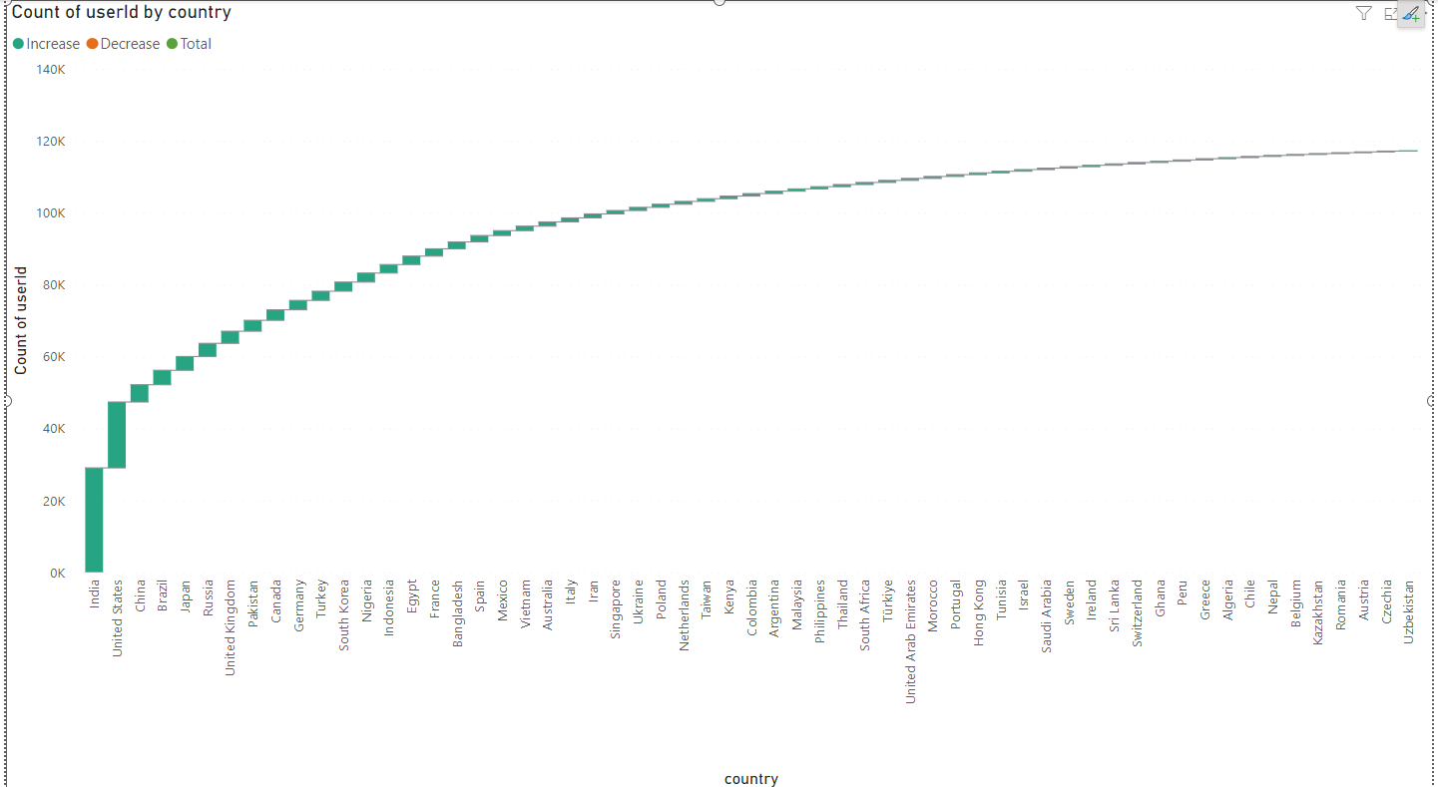
Recommendations:
Targeted Marketing and User Outreach: Implement targeted marketing campaigns and user outreach strategies in regions or countries where user activity has declined. By understanding the factors contributing to the drop in activity, Kaggle's can tailor initiatives to re-engage dormant users and reignite their interest in the platform.
Personalized Content and Competitions: Create personalized content and competitions that cater to different user segments, including beginners, intermediate, and advanced users. Tailoring content and challenges based on skill levels will foster a sense of inclusivity, encourage skill progression, and attract a diverse user base.
Enhance User Experience: Invest in improving the platform's user experience by streamlining the competition participation process and enhancing collaboration features. Making it easier for users to participate in competitions and collaborate with others will lead to higher user satisfaction and increased engagement.
Strategic Event Scheduling: Leverage the insights gained from time-based analysis to identify peak user activity periods. By strategically scheduling high-impact events, Kaggle's can capitalize on user interest and maximize participation, ultimately driving greater engagement on the platform.

Slide 12
Conclusions:
In conclusion, the analysis of Kaggle's active user data and their country and region breakdown has provided valuable insights into user engagement patterns. It is evident that certain regions and countries exhibit higher user activity levels, while others may require targeted efforts to re-engage users.
By leveraging these insights, Kaggle's can develop more effective strategies to enhance user engagement and platform retention.
Implementing personalized content, refining the user experience, and optimizing competition scheduling based on peak activity periods are essential steps to drive long-term success.
Moreover, fostering a culture that embraces change and innovation will play a pivotal role in sustaining Kaggle's growth and maintaining its position as a leading data science platform.
By taking action on these recommendations, Kaggle's can further solidify its reputation as a vibrant community that empowers data enthusiasts and professionals worldwide

